Slide 1
Functor is to Lens as Applicative is to Biplate – Introducing Multiplate By Russell O’Connor
Presented by Beerend Lauwers

Slide 2
Introduction
Show that Uniplate and Compos data types are isomorphic
Develop a third library (Multiplate) that combines the two

Slide 3
How do we get there?
The Lens structure
The Store Comonad
Lens as a Coalgebra of the Store Comonad
The Cartesian Store Comonad and Biplates
Biplates as a Coalgebra of the Cartesian Store Comonad
Show that Uniplate and Compos data types are isomorphic
Multiplate

Slide 4
The Lens Structure
During programming, you often have tree-like data structures you wish to manipulate
For example, replacing a subtree (or subexpression)
Often used for abstract syntax trees, which are often built from mutually recursive data types
Lens structure = functional reference or accessor
data Lens α β = Address { get :: α → β, set :: α → β → α }
Used for manipulating subexpressions

Slide 5
The Store Comonad – Comonad?
Dual to Monad
Monads “put things into a box”
Comonads “pull things out of a box”
(>>=) chains action 1 to action 2
(extend) chains action 2 to action 1
Monads take into account past computations
Comonads take into account future computations

Slide 6
The Store Comonad – Comonad Definition
class Functor w ⇒ Comonad w where
extract :: w α → α -- (Dual to return)
duplicate :: w α → w (w α)
duplicate = extend id -- (Dual to join)
extend :: (w α → g) → w α → w g -- (Dual to bind)
extend f x = fmap f (duplicate x)

Slide 7
The Store Comonad
Dual to the State monad
Also called costate, context, state-in-context
data Store β α = Store { peek :: β → α, pos :: β }

Slide 8
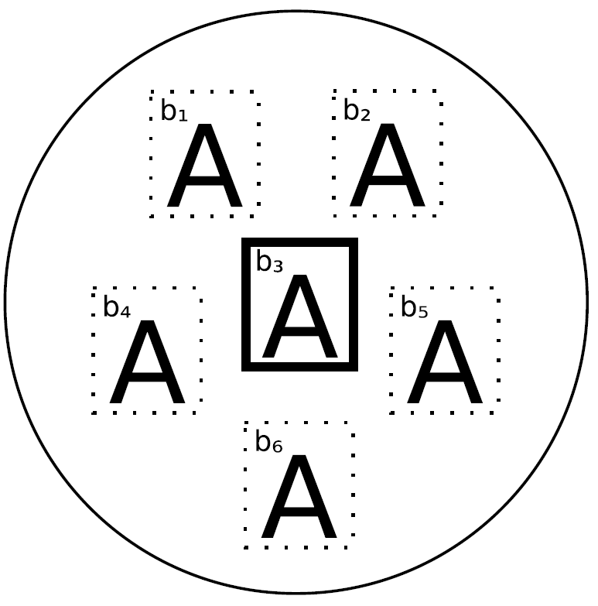
The Store Comonad - Example
The a values can vary, but for simplicity data type A is used everywhere
Each A value belongs to a location labeled with b_{i}
b₃ is currently the “selected” location: if extract is called upon this comonad, it will be the value returned

Slide 9
The Store Comonad
Dual to the State monad
Also called costate, context, state-in-context
data Store β α = Store { peek :: β → α, pos :: β }
It is a Comonad for every β with the following comonadic operations:
instance Functor (Store β) where
fmap f (Store v b) = Store (f ◦ v) b
instance Comonad (Store β) where
extract (Store v b) = v b
duplicate (Store v b) = Store (Store v) b

Slide 10
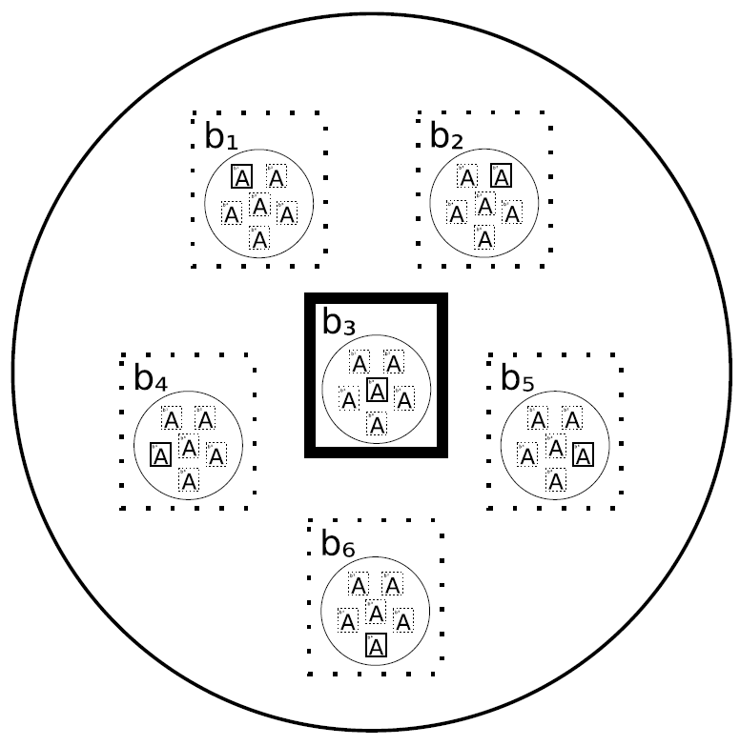
The Store Comonad - duplicate
duplicate produces interesting results:
Produces a collection of all possible selections for the input
Each cell b_{i} is replaced with a copy of the original collection, but with cell b_{i} selected within that collection

Slide 11
How do we get there?
The Lens structure
The Store Comonad
Lens as a Coalgebra of the Store Comonad ←
The Cartesian Store Comonad and Biplates
Biplates as a Coalgebra of the Cartesian Store Comonad
Show that Uniplate and Compos data types are isomorphic
Multiplate

Slide 12
Lens as a Coalgebra of the Store Comonad
type Lens α β = α → Store β α
Let’s look at an example
data Address = Address { phone_ :: PhoneNumber,
website_ :: URI }
patrick = Address { phone_ = 333-4444,
website_ = http://www.patrick.com }
phoneLens :: Lens Address PhoneNumber
phoneLens = λ addr → Store peek = (λ newnumber → addr { phone_ = newnumber } ), pos = (phone_ addr)

Slide 13
Lens as a Coalgebra of the Store Comonad
Let’s dissect this a bit:
(λ newnumber → addr { phone_ = newnumber }
-- (PhoneNumber → Address )
An update function (peek)
(phone_ addr) -- PhoneNumber
pos component
Given an Address,
Produce a Store PhoneNumber Address,
peek :: (PhoneNumber → Address )
pos :: PhoneNumber

Slide 14
Lens as a Coalgebra of the Store Comonad
A lens is isomorphic to a pair of getter and setter functions: Lens α β ≈ (α → β) x (α → β → α)
From Lens
To Lens
get :: Lens α β → α β
get lens a = pos (lens a)
set :: Lens α β → α → β → α
set lens a = peek (lens a)
lens :: (α → β) → (α → β → α) → Lens a b
lens getf setf = λ a -> Store (setf a) (getf a)

Slide 15
Lens as a Coalgebra of the Store Comonad
Example
-- get lens a = pos (lens a)
get phoneLens patrick = 333-4444
-- set lens a = peek (lens a)
set phoneLens patrick 555-666 = Address { phone_ = 555-666, website_ = http://www.patrick.com }

Slide 16
Lens as a Coalgebra of the Store Comonad
The get and set functions should satisfy certain laws:
get l (set l s b) = b
set l s (get l s) = s
set l (set l s b1) b2 = set l s b2
We can express these laws using the comonadic operations for the Store Comonad:
extract ◦ l = id
fmap l ◦ l = duplicate ◦ l

Slide 17
Lens as a Coalgebra of the Store Comonad
For all l of type Lens α β, (1) holds iff (2) holds.
A coalgebra for a Functor F is a function f :: A → F A for some type A
If W is a Comonad, f :: A → W A is a coalgebra for the Comonad W iff (2) is satisfied
Hence, Lenses are exactly the coalgebras for the Store Comonad

Slide 18
How do we get there?
The Lens structure
The Store Comonad
Lens as a Coalgebra of the Store Comonad
The Cartesian Store Comonad and Biplates ←
Biplates as a Coalgebra of the Cartesian Store Comonad
Show that Uniplate and Compos data types are isomorphic
Multiplate

Slide 19
The Cartesian Store Comonad and Biplates - Biplate
Uniplate’s core data type: Biplate
type Biplate α β = α → ([β] x ([β] → α))
Isomorphic to Lens α [β], except that:
First [β] should be of same length as second [β]
References to multiple substructures
Substructures can be retrieved and simultaneously updated

Slide 20
The Cartesian Store Comonad and Biplates - Biplate
What they really wanted to write:
type Biplate α β = a → ∃n : Nat. β^{n}×(β^{n}→α)
Could use GADTs
van Laarhoven’s data type uses nested data types:
data CartesianStore β α = Unit α |
Battery (CartesianStore β (β -> α)) β
Looks pretty similar, but a Cartesian Store has multiple dimensions: Cartesian Store items are indexed by a coordinate system of some dimension
data Store β α = Store { peek :: β → α, pos :: β }

Slide 21
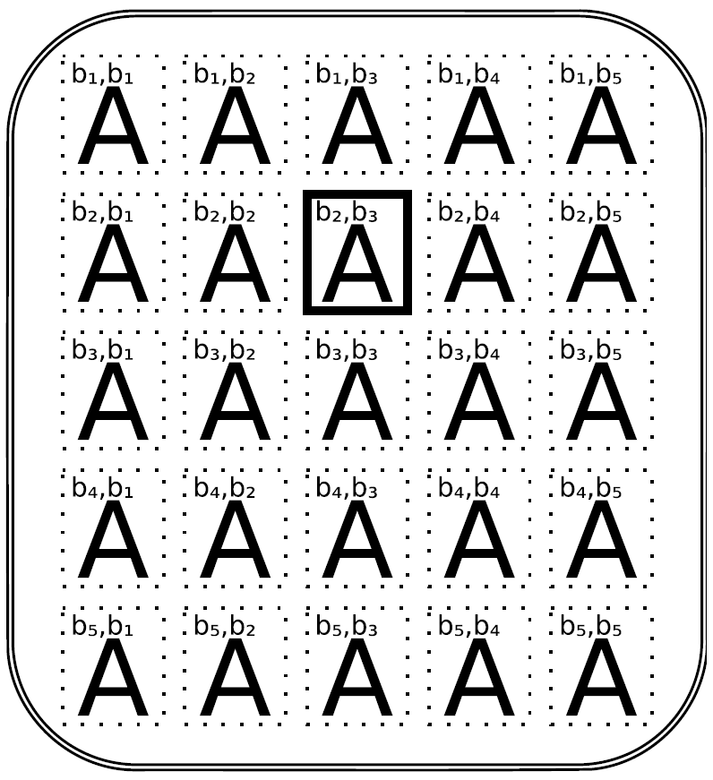
The Cartesian Store Comonad and Biplates - Example
Dimension = 2
Selected location = {b₂, b₃}
Battery (Battery (Unit (x :: b → b → a) ) b₃) b₂
Our x function takes the same amount of arguments as we have b’s

Slide 22
The Cartesian Store Comonad and Biplates – Cartesian Store Comonad
Comonadic operations for the Cartesian Store:
instance Functor (CartesianStore β) where
fmap f (Unit a) = Unit (f a)
fmap f (Battery v b) = Battery (fmap (f ◦ ) v) b
instance Comonad (CartesianStore β) where
extract (Unit a) = a
extract (Battery v b) = extract v b
duplicate (Unit a) = Unit (Unit a)
duplicate (Battery v b) = Battery (extend Battery v) b

Slide 23
The Cartesian Store Comonad and Biplates – Cartesian Store Comonad
There is some extra structure in the Cartesian Store
Battery (Battery (Unit (x :: b → b → a) ) b₂) b₁
We can also have an instance of Applicative
instance Applicative (CartesianStore β) where
pure = Unit
f <*> (Unit a) = fmap ($ a) f
f <*> (Battery v b) = Battery ((◦) <$> f <∗> v) b
Cartesian Store is a generalization of Store
We can transform a Store into a Cartesian Store:
singleStore (Store v b) = Battery (Unit v) b

Slide 24
How do we get there?
The Lens structure
The Store Comonad
Lens as a Coalgebra of the Store Comonad
The Cartesian Store Comonad and Biplates
Biplates as a Coalgebra of the Cartesian Store
Comonad ←
Show that Uniplate and Compos data types are isomorphic
Multiplate

Slide 25
Biplates as a Coalgebra of the Cartesian Store Comonad
We can define a Comonad of which the function component only accepts inputs that are the same length as the data component of the value
We can define a Biplate as such:
type Biplate α β = α →CartesianStore β α
This means Biplates must be coalgebras of the Cartesian Store Comonad
So they need to satisfy the two coalgebraic laws:
extract ◦ l = id
fmap l ◦ l = duplicate ◦ l

Slide 26
Biplates as a Coalgebra of the Cartesian Store Comonad
Actually, a Biplate is a generalization of Lens:
A Lens is a reference to a substructure inside a large structure
A Biplate is a reference to a list of 0 (or more) substructures inside a large structure
Thus, a Lens is a Biplate where the amount of substructures referenced is exactly one

Slide 27
How do we get there?
The Lens structure
The Store Comonad
Lens as a Coalgebra of the Store Comonad
The Cartesian Store Comonad and Biplates
Biplates as a Coalgebra of the Cartesian Store Comonad
Show that Uniplate and Compos data types are isomorphic ←
Multiplate

Slide 28
Show that Uniplate and Compos data types are isomorphic – Store A B representation
Different representation of Store A B:
∀κ : Functor. (B→κB)→κA
Why this representation? → The parametricity will greatly restrict what the values of this data type can be

Slide 29
Show that Uniplate and Compos data types are isomorphic – Store A B representation
∀κ : Functor. (B→κB)→κA
Brainstorm: How can we produce a value of κA?
The only tool we can use is fmap_{k}
We have to utilize our parameter f :: B→κB
So, our type needs to internally have a value b :: B, and apply it to f, yielding a κB.
But how can we transform our κB to a κA?
Our type will also have to hold a value v :: B → A, so we can use fmap_{k} v to get a κA
In conclusion, we need a B and a B → A.
These are exactly the two components of Store B A!

Slide 30
Show that Uniplate and Compos data types are isomorphic – Store A B representation
isoStore₁ :: Store B A → ∀κ : Functor. (B → κB) → κA
isoStore₁ (Store v b) = λ κ → λ f → fmap_{κ} v (f b)
isoStore2 :: (∀κ : Functor. (B → κB) → κA) → Store B A
isoStore2 y = y_{(Store B)} idLens_{B}
This isomorphism implies the following set of isomorphisms:
Store B A ≈ ∀κ :: Functor. (B → κB) → κA
Lens A B ≈ A → ∀κ :: Functor. (B → κB) → κA
Lens A B ≈ ∀κ :: Functor. (B → κB) → A → κA
(van Laarhoven representation for a lens)

Slide 31
Show that Uniplate and Compos data types are isomorphic – Store A B representation
We can transport Lens laws through the isomorphism to get laws for van Laarhoven lenses
Reasoning this way is awkward
Is there a more natural way? Yes!
type Coalgebra α κ = α → κ α
Arguments are flipped: Coalgebra α :: (⋆ → ⋆) → ⋆
Think of it as a functor from functors-on-types to types

Slide 32
Show that Uniplate and Compos data types are isomorphic – Store A B representation
type κ₁ ⇒ κ₂ = ∀α. κ₁ α → κ₂ α
coalgMap :: (κ₁ ⇒ κ₂) → Coalgeba β κ₁ → Coalgebra β κ₂
coalgMap η c = η◦c
If we have a natural transformation between functors on types,
... we can “map” over a coalgebra

Slide 33
Show that Uniplate and Compos data types are isomorphic – Store A B representation
We can rewrite the type of a van Laarhoven lens:
l :: ∀κ : Functor. (B → κB) → A → κA
l :: ∀κ : Functor. Coalgebra B κ → Coalgebra A κ
It’s the type of a natural transformation from Coalgebra B to Coalgebra A
We get a free theorem: coalgMap η◦l = l◦ coalgMap η
Both the category of functors and the category of types are monoidal categories

Slide 34
Show that Uniplate and Compos data types are isomorphic – Store A B representation
Coalgebras preserve this monoidal structure with the following operations:
idCoalg :: 1 → Coalgebra α Id
idCoalg () = id
composeCoalg :: (Functor κ₁, Functor κ₂) ⇒
(Coalgebra α κ₁ × Coalgebra α κ₂) → Coalgebra α (κ₁ ◦ κ₂)
composeCoalg (c1, c2) = fmapκ₁ c2 ◦ c1
Given that Coalgebra A and Coalgebra B are both monoidal functors,
… we note that l is actually a monoidal natural transformation

Slide 35
Show that Uniplate and Compos data types are isomorphic – Store A B representation
The laws for a monoidal natural transformation lens are the following
l (idCoalg ()) = idCoalg ()
l (composeCoalg (c1, c2)) = composeCoalg (l c1, l c2)

Slide 36
Show that Uniplate and Compos data types are isomorphic – Store A B representation
Let’s recall (1) and (2) :
get l (set l s b) = b
set l s (get l s) = s
set l (set l s b1) b2 = set l s b2 (1 : Very well behaved lens)
extract ◦ l = id
fmap l ◦ l = duplicate ◦ l (2 : (1) expressed for Comonads)
l (idCoalg ()) = idCoalg ()
l (composeCoalg (c1, c2)) = composeCoalg (lc1, lc2) (3)
(3) is satisfied iff (2) holds, and (1) holds iff (2) holds
Thus, (1), (2) and (3) are all equivalent
Three different characterizations of two different representations of a lens structure

Slide 37
Show that Uniplate and Compos data types are isomorphic – Cartesian Store A B representation
Similarly, CartesianStore A B can be represented as
∀κ : Applicative. (B → κB) → κA
Again, parametricity restricts what these values can do
But now, we can also use pure and <*>
If our value contains an a :: A, we can just return pure_{k} a
If our value contains a b :: B and a function v :: B → A, we can return pure_{k} v <*>_{k} f b
Because <*> _{k} is defined as fmap_{k} v x = pure_{k} v <*>_{k} x, it is essentially identical to the lens case

Slide 38
Show that Uniplate and Compos data types are isomorphic – Cartesian Store A B representation
There are other possibilities:
Two values b₁, b₂ :: B
Function v :: B -> B -> A
We would return pure _{k} v <*> _{k} f b₁ <*> _{k} f b₂
We could keep adding B’s
In essence, we have the following type:
A + (B₁ → A) × B₁ + (B₂ → A) × B₂ + …
≈ ∃n : Nat. (B^{n} → A) × B^{n}
≈ CartesianStore B A

Slide 39
Show that Uniplate and Compos data types are isomorphic – Cartesian Store A B representation
We can produce a value of the polymorphic type like so:
-- ∀κ : Applicative. (B → κB) → κA
isoCartesianStore₁ :: CartesianStore B A →
(∀κ : Applicative. (B → κB) → κA)
isoCartesianStore₁ (Unit a) = λ κ → λ f → pure_{κ} a
isoCartesianStore₁ (Battery v b) = λ κ → λ f →(isoCartesianStore₁ v)_{κ} f <*>_{κ} f b
van Laarhoven had a feeling that CartesianStore A B and ∀κ : Applicative. (B → κB) → κA are isomorphic

Slide 40
Show that Uniplate and Compos data types are isomorphic – Cartesian Store A B representation
They are
isoCartesianStore₂ :: (∀κ : Applicative. (B → κB) → κA) → CartesianStore B A
isoCartesianStore₂ y = y (CartesianStore B) idBiplate_{B}
This isomorphism implies the following set of isomorphisms:
CartesianStore B A ≈ ∀κ :: Applicative. (B → κB) → κA
Biplate A B ≈ A → ∀κ :: Applicative. (B → κB) → κA
Biplate A B ≈ ∀κ :: Applicative. (B → κB) → A → κA

Slide 41
Show that Uniplate and Compos data types are isomorphic – Cartesian Store A B representation
Again, coalgebra laws for Biplates are equivalent to the laws for a monoidal natural transformation
It turns out that ∀κ : Applicative. (A → κA) → A → κA is exactly the type of compos from the Compos library
Hence, Uniplate and Compos use (in essence) isomorphic representations

Slide 42
Multiplate!
Let’s look at the van Laarhoven representation of a Biplate again:
∀κ : Applicative. (B → κB) → (A → κA)
∀κ : Applicative. (B → κB) → (C → κC) → (A → κA)
Suppose we want to extend the type to support different types of substructures of A (which is the main structure)
The natural way would be to add more parameters:
∀κ : Applicative. (A→κA)→(B→κB)→(C→κC)→(A→κA)
∀κ : Applicative. (A→κA)→(B→κB)→(C→κC)→(B→κB)
∀κ : Applicative. (A→κA)→(B→κB)→(C→κC)→(C→κC)
This will get ugly fast!

Slide 43
Multiplate
Compos supports mutually recursive data types through GADTs
Uniplate resorts to multiparameter type classes
But Uniplate supports updating only a single pair of parent-child types at a time
Ideally, we do not want to require GADTs or multiparameter type classes
To do this, we will use rank-3 polymorphism

Slide 44
Multiplate
Instead of creating three multireference types, we can combine them
This “matrix transformation” will operate on a “vector” of coalgebras
Let’s define a record type parametrized by applicative functions:
data P κ =
{ coalgA :: A→κA, coalgB :: B→κB, coalgC :: C→κC }
Then, we can just write a single type:
∀κ : Applicative. P κ → P κ

Slide 45
Multiplate
We can give generic implementations of traversal operations for a given P
Let’s take a non-generic example first

Slide 46
Multiplate – Example Language
data Stm = SDecl Typ Var | SAss Var Expr | SBlock [Stm] |
SReturn Expr
data Expr = EStm Stm | EAdd Expr Expr | EVar Var |
EInt Int
data Var = V String
data Typ = TInt | TFloat
What now?
→ For each type, we need a record type with a field for a coalgebra
This record is then parametrized by an applicative functor
Let’s call this a plate

Slide 47
Multiplate – Plate data type
data Plate κ = Plate {stm :: Stm →κ Stm,
expr :: Expr →κ Expr,
var :: Var →κ Var,
typ :: Typ →κ Typ }

Slide 48
Multiplate – Providing the functional multireference
multiplate :: Applicative κ ⇒ Plate κ → Plate κ
multiplate p = Plate { stm = buildStm, expr = buildExpr,
var = buildVar, typ = buildTyp }
where
buildStm (SDecl t v) = SDecl <$> typ p t <∗> var p v
buildStm (SAss v e) = SAss <$> var p v <∗> expr p e
buildStm (SBlock ss) = SBlock <$> traverse (stm p) ss
buildStm (SReturn e) = SReturn <$> expr p e
buildExpr (EStms) = EStm <$> stm p s
buildExpr (EAdd e1 e2) = EAdd <$> expr p e1 <*> expr p e2
buildExpr (EVar v) = EVar <$> var p v
buildExpr x = pure x
buildVar x = pure x
buildTyp x = pure x

Slide 49
Multiplate – Example function, Compos Style
Using multiplate, we can for example define a collection of rename functions
rename :: Plate Id
rename = Plate { stm = stm (multiplate rename),
expr = expr (multiplate rename),
var = (λ s) → pure_{Id} (V (‘_’ : s)),
typ = typ (multiplate rename) }
These recursive calls will rename all Stm and Expr
This is the way Compos does it
Uniplate does it differently

Slide 50
Multiplate – Example function, Uniplate Style
Uniplate defines a generic traversal function
mapFamily :: Plate Id → Plate Id
mapFamily p = p ‘composePlateId‘ multiplate (mapFamily p)
where
composePlateId :: Plate Id → Plate Id → Plate Id
p1 ‘composePlateId‘ p2 =
Plate { stm = stm p1 ◦ stm p2,
expr = expr p1 ◦ expr p2,
var = var p1 ◦ var p2,
typ = typ p1 ◦ typ p2 }

Slide 51
Multiplate – Example function, Uniplate Style
purePlate :: Applicative κ ⇒ Plate κ
purePlate = Plate { stm = pure, expr = pure,
var = pure, typ = pure }
rename = mapFamily (purePlate {var = renameVar})
where
renameVar (V s) = pure (V(’_’: s))
Only cases we are interested in are defined
The rest are handled generically

Slide 52
Multiplate – Monadic multiplate
Using Kleisli composition, we can generalize composePlate to monads:
kleisliComposePlate :: Monad m ⇒ Plate m → Plate m → Plate m
p1 ‘kleisliComposePlate‘ p2 =
Plate { stm = stm p1 <=< stm p2,
expr = expr p1 <=< expr p2,
var = var p1 <=< var p2,
typ = typ p1 <=< typ p2 }
mapFamilyM :: Monad m ⇒ Plate m → Plate m
mapFamilyM p = p ‘kleisliComposePlate‘ multiplate (mapFamilyM p)

Slide 53
Multiplate – Generic Multiplate
This is all quite nice, but we’d like to generalize our functions for all mutually recursive datatypes
We need to create a type class for plates
We also need a generic way of building plates
The record fields of purePlate, mapFamilyM, etc, are built in a uniform way
So if we give a polymorphic function ∀α. α→κ α, we can build an arbitrary plate Pκ for an arbitrary applicative functor κ
We also need a projection function to pass to our builder function

Slide 54
Multiplate – Generic Multiplate
type Projector ρ α = ∀κ. p κ → α → κ α
We can pass this to a generic builder function to have it create the corresponding field of our record
We need the user to provide a second function:
mkPlate :: (∀α. Projector p α → α → κ α) → p κ
mkPlate builder = Plate { stm = builder stm,
expr = builder expr,
var = builder var,
typ = builder typ }

Slide 55
Multiplate – Generic Multiplate
Putting multiplate and mkPlate together, we get the Multiplate class:
class Multiplate ρ where
multiplate :: Applicative κ ⇒ ρ κ → ρ κ
mkPlate (∀α. Projector ρ α → α → κ α) → ρ κ
With this class, we can define generic versions of purePlate, kleisliComposePlate, mapFamilyM, and more

Slide 56
Multiplate – Generic Multiplate
purePlate :: (Multiplate ρ, Applicative κ) ⇒ ρ κ
purePlate = mkPlate (const pure)
idPlate :: Multiplate ρ ⇒ ρ Id
idPlate = purePlate
mapPlate :: ∀ρ κ₁ κ₂. Multiplate ρ ⇒ (∀ g. κ₁ g→κ₂ g)→ρ κ₁ →ρ κ₂
mapPlate η p = mkPlate build
where
build :: Projector ρ α → α → κ₂ α
build r = η ◦ r p

Slide 57
Multiplate – Generic Multiplate
composePlate :: ∀ρ κ₁ κ₂. (Multiplate ρ, Applicative κ₁, Applicative κ₂) ⇒ ρ κ₁→ρ κ₂→ρ (κ₂ ◦ κ₁)
p1 ‘composePlate‘ p2 = mkPlate build
where
build :: Projector ρ α → α → κ₂ (κ₁ α)
build r = fmapκ₂ (r p1) ◦ r p2
kleisliComposePlate :: (Multiplate ρ, Monad m) ⇒ ρ m →ρ m→ ρ m
p1 ‘kleisliComposePlate‘ p2 = mapPlate join (p1 ‘composePlate‘ p2)
mapFamilyM :: (Multiplate ρ, Monad m) ⇒ ρ m → ρ m
mapFamilyM p = p ‘kleisliComposePlate‘ multiplate (mapFamilyM p)

Slide 58
Multiplate – Generic Multiplate
We can write code for generic folding like Compos does it
instance (Monoid o) ⇒ Applicative (Const o) where
pure x = 1_{o}
f <*> x = f ∗_{o} x
appendPlate :: ∀ρ o. (Multiplate ρ, Monoid o) ⇒
ρ (Const o) → ρ (Const o) → ρ (Const o)
p1 ‘appendPlate‘ p2 = mkPlate build
where
build :: Projector ρ α → α → m α
build r a = r p1 a <∗> r p2 a
preorderFold :: (Multiplate ρ, Monoid o)⇒ρ (Const o)→ρ (Const o)
preorderFold p = p ‘appendPlate‘ multiplate (preorderFold p)
postorderFold :: (Multiplate ρ, Monoid o)⇒ρ (Const o)→ρ (Const o)
postorderFold p = multiplate (postorderFold p) ‘appendPlate‘

Slide 59
Multiplate – Multiplate Laws
The Multiplate library is generic enough that you can define your own plate structure, as long as it satisfies the multiplate laws:
multiplate idPlate = idPlate
multiplate (composePlate p1 p2) = composePlate (multiplate p1) (multiplate p2)

Slide 60
Multiplate - Conclusions
Compos requires you to rewrite your data type as a GADT
Uniplate’s Biplate doesn’t allow for simultaneous modification of different data types
Multiplate can use the user’s mutually recursive data type
Multiplate can update different data types at the same time
Multiplate only requires rank 3 polymorphism

Slide 61
Thanks for your time

Slide 62
Questions?

